Slide 1


KS1 SATs
May
2020
Things we will cover:-
What are SATs in Key Stage 1?
What do the SATs tests look like?
How do teachers assess/results?
Age related expectations
What can you do to help?
A parents guide for Year 2 children

Slide 2
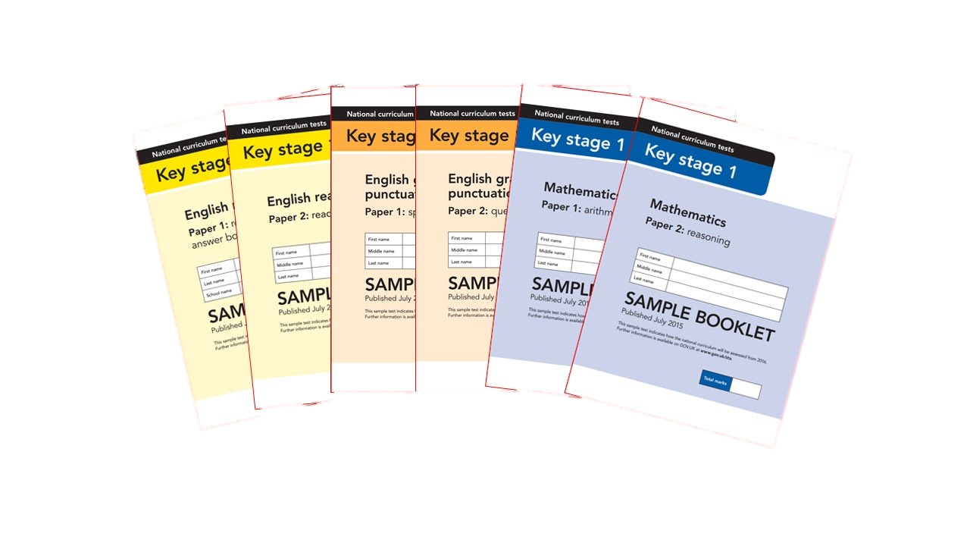
What are SATs?
At the end of Year 2, children in England sit national tests in the following subjects, the results are used to measure the school’s performance:-
*English – Reading
*English – Grammar, Punctuation & Spelling
*Maths – Arithmetic & Reasoning
These tests reflect the updated national curriculum and are marked using the current grading system.
https://www.gov.uk/government/collections/national-curriculum-assessments-practice-materials
Scroll to the bottom and choose KS1 tests

Slide 3
How are SATs run at PTM?
At PTM, we really value mental health and well being so we make sure that your child has a calm and relaxed experience in the lead up to SATs and while sitting them.
Your child will be familiar with SATs style questions/tests as they will be exposed to these types of questions throughout Year 2.
SATs are completed in small groups with familiar adults, this means that the children can remain happy and focussed during their SATs.
SATs are completed during the month of May.

Slide 4
An outline of the tests
Paper 1
Paper 2
Reading booklet with
questions and answer spaces
combined.
Reading booklet with a separate booklet which has the questions and answer spaces.
English Reading
Each paper for the KS1 Reading SATs is worth 50% of the available marks.

Slide 5
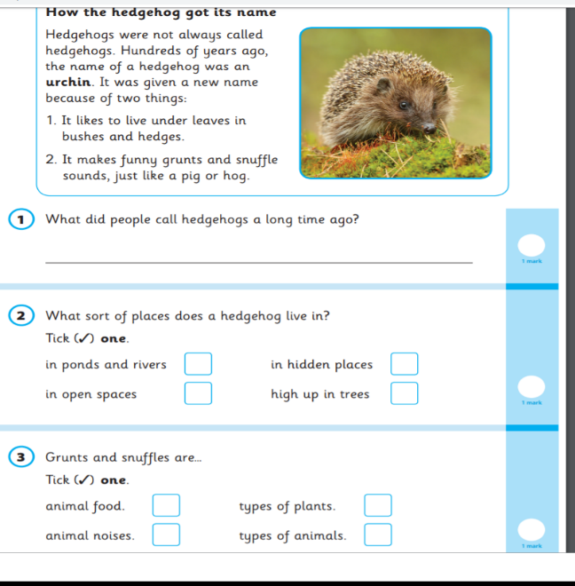
English – Reading
Paper 1 Example Page

Slide 6
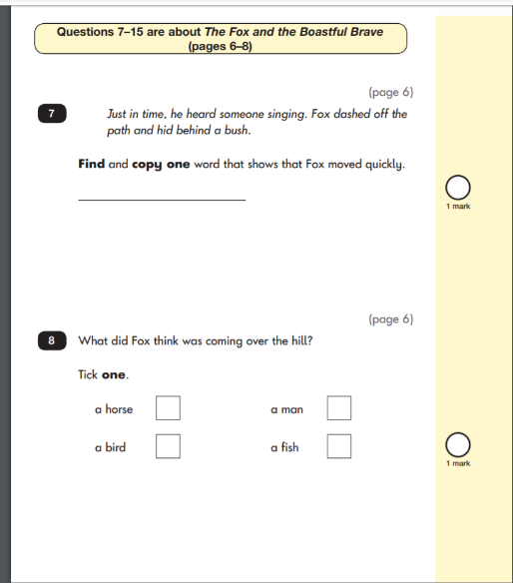



English – Reading
Paper 2 Example Pages
applefortheteacher.co.uk

Slide 7
English
English
Grammar, Punctuation & Spelling
Paper 1
Spelling test of 20 words
Paper 2
Question paper to check grammar, punctuation and vocabulary

Slide 8
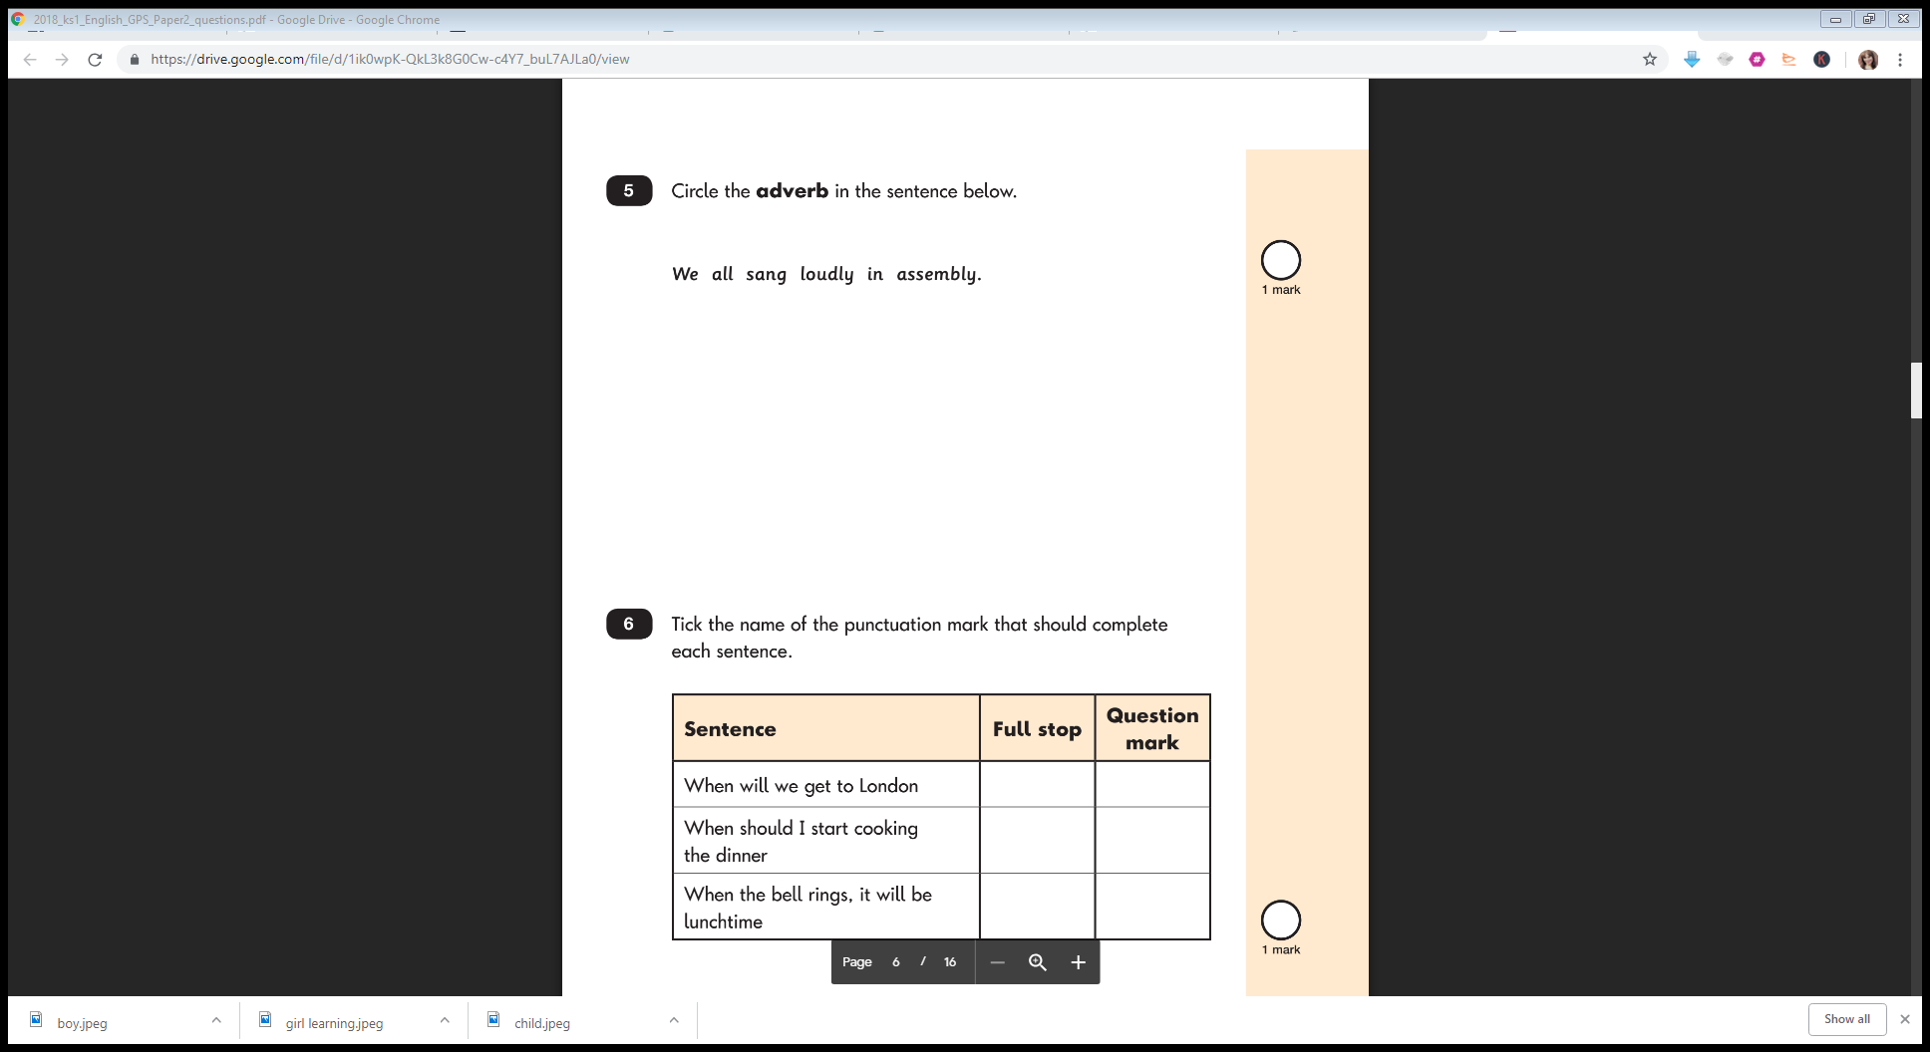
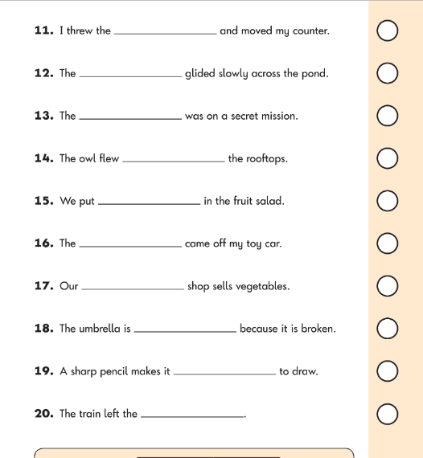
English – Spelling Example Page
English – Grammar Example Page

Slide 9
Maths
Paper 1
Paper 2
Arithmetic
Reasoning, problem solving and mathematical fluency
Arithmetic
& Reasoning
(25 marks available)
(35 marks available)

Slide 10
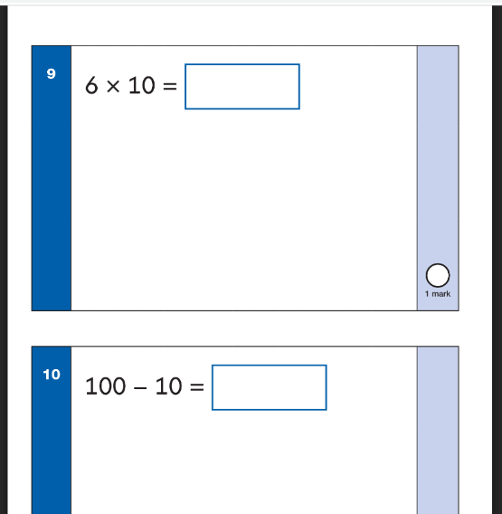
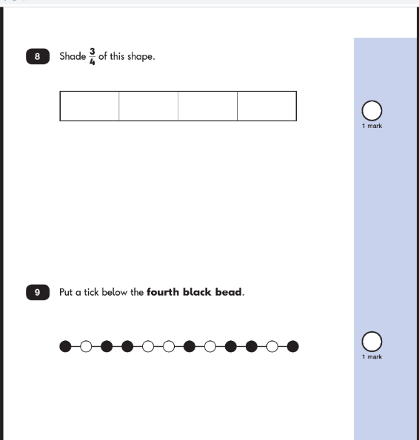
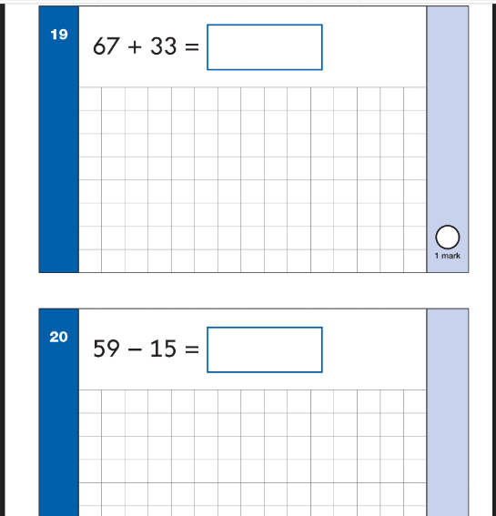
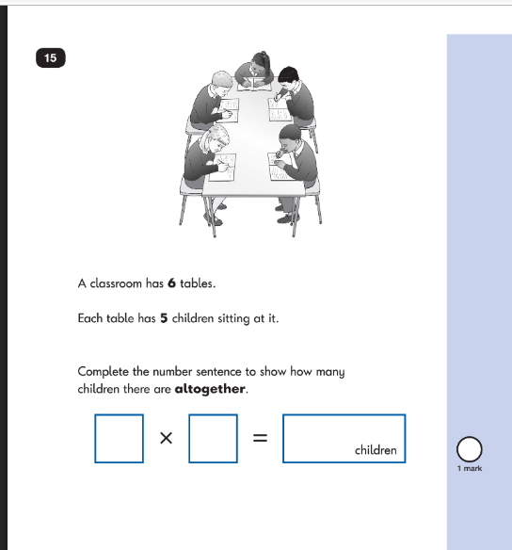
Maths Paper 1 Example Pages (Arithmetic)
Maths Paper 2 Example Pages (Reasoning)

Slide 11
Teacher Assessment/results
KS1 SATs tests are one part of evidence towards the whole teacher assessment.
They are marked in school, and an overall grading based on the whole year’s work will be made.
The results of the SATs tests are reported to the Local Authority.
Parents will also receive an end of year report detailing their child’s end of year standard.
Moderation often takes place to ensure consistency across schools.

Slide 12
Age Related Expectations
Pre-key stage standards (not working within the Year 2 Curriculum).
Working towards the expected standard (some of the learning is within the Year 2 Curriculum).
Working at the expected standard (all learning is within the Year 2 Curriculum).
Working at greater depth (very secure in Year 2 Curriculum, with elements of Year 3).
applefortheteacher.co.uk

Slide 13
How can you help your child prepare?
Help your child with reading - listen to them read and focus on bringing out a ‘love of reading’. Also reading stories to your child allows them to develop language, listening skills and comprehension. Encourage making predictions of what might happen next.
Help your child with writing - support with weekly spellings, write together to make shopping lists and letter writing. Encourage your child to use adjectives to make their work exciting and remind them to use capital letters and full stops consistently.
Help your child with maths - play times table games, encourage them to help with cooking, weighing and measuring ingredients, work out what time it is together, provide opportunities for your child to pay for things in a shop, to work out how much things cost and how much change will be needed. Practise addition and subtraction questions using numbers up to 100.

Slide 14

Thank You!
Your time is appreciated.
Any Questions?

