Slide 1



The zones of regulation at ptm

Slide 2
What is The Zones of Regulation?
From Reception through to Year 6 we follow the Zones of Regulation curriculum. The Zones of Regulation curriculum includes lessons and activities designed by Leah Kuypers (Occupational Therapist). The curriculum aims to support children with self-regulation. The lessons and activities enable pupils to identify when they are in the different zones and how to use strategies to change or stay in the zone they are in. Pupils will gain a greater understanding of emotions, reading other people’s facial expressions, understanding of how others see and react to their behaviour, an understanding of what may trigger their behaviour, calming and alerting strategies and problem solving skills.

Slide 3
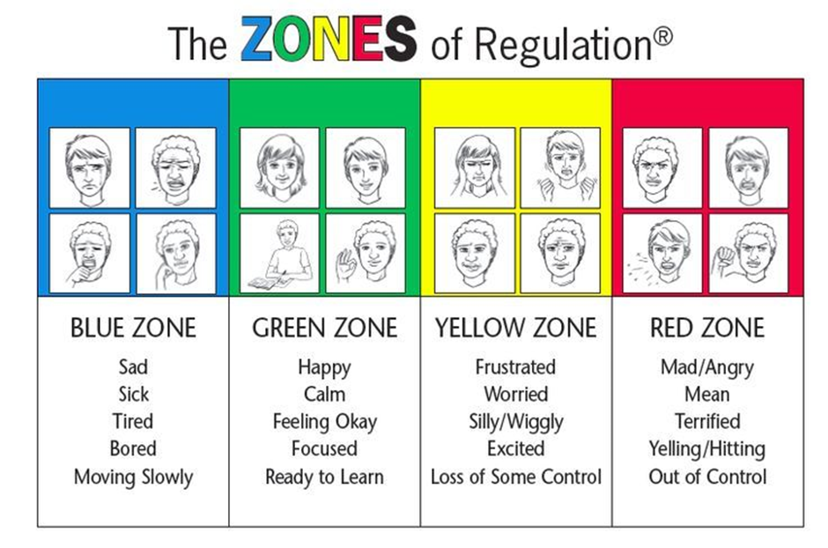

Slide 4
Our Principles
It’s okay to be in any zone. As adults we can be in these zones and it is important to discuss our own emotions.
Children need to be able to identify what zone they are in and what they can do when they are in that zone.
Teaching the children what to do in each zone will help them to be successful at school, at home and in the community.
Using the zones will allow the children to be safe, respectful and responsible.

Slide 5
How do we teach the Zones?
The children in our Nursery and Pre-school are not taught about the Zones however staff will use the language related to emotions and will support children in self regulating their emotions.
From Reception the children will be taught how to identify the different types of emotions, how our emotions effect us and others and different tools to support self-regulation.
Children in Year 1 to 6 will recap their learning through assemblies and whole class sessions. There may be some children who need more individual support to self-regulate their emotions. This will usually be supported by the adults in their class.

Slide 6
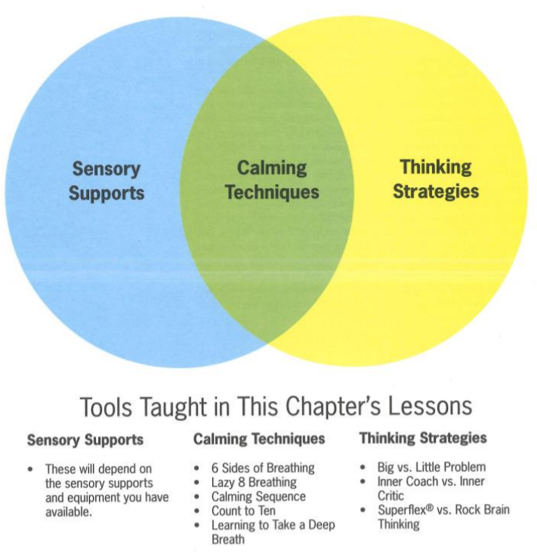

Slide 7
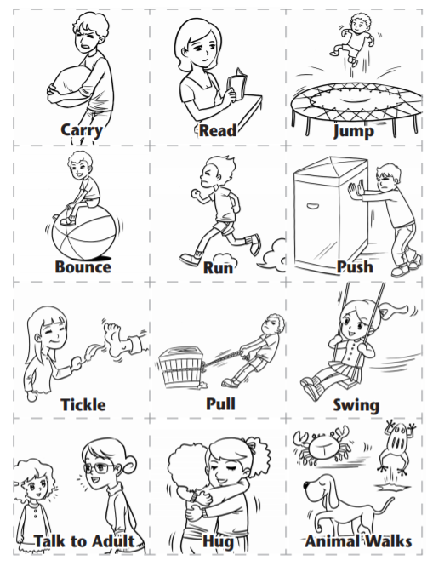
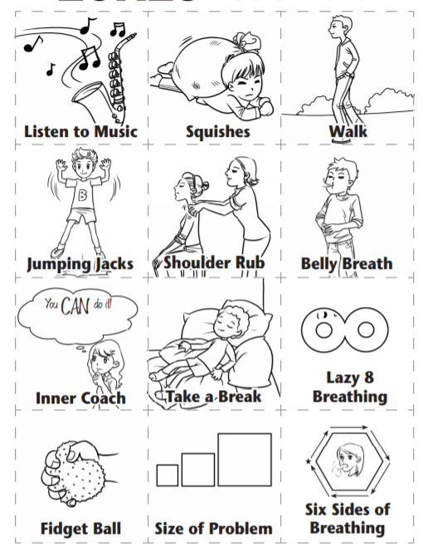

Slide 8
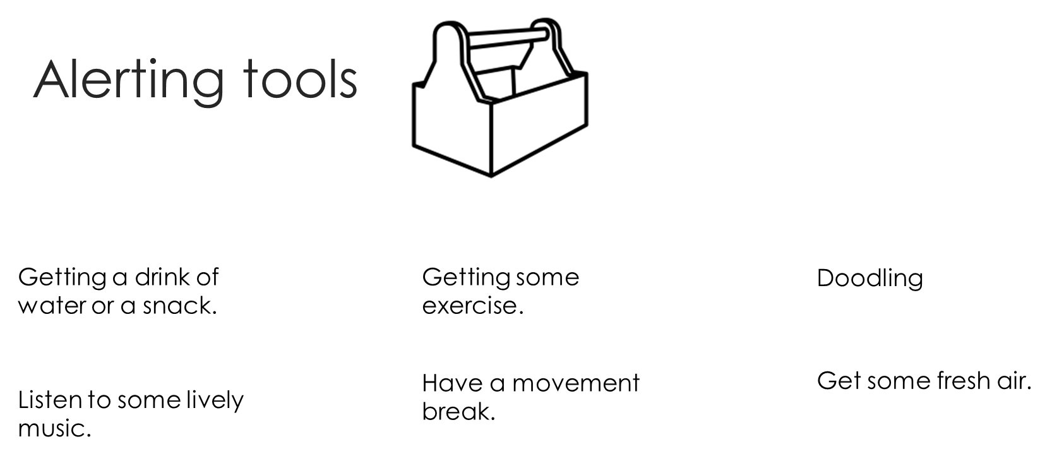

Slide 9
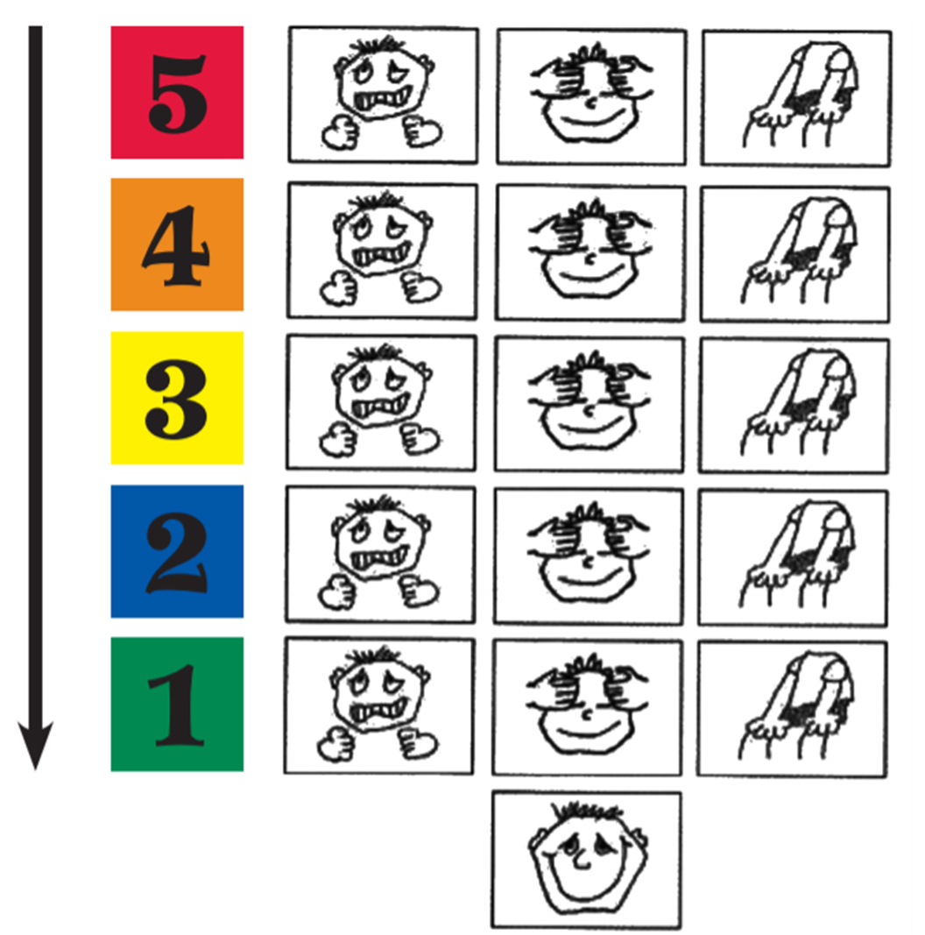
Calming Tools

Slide 10
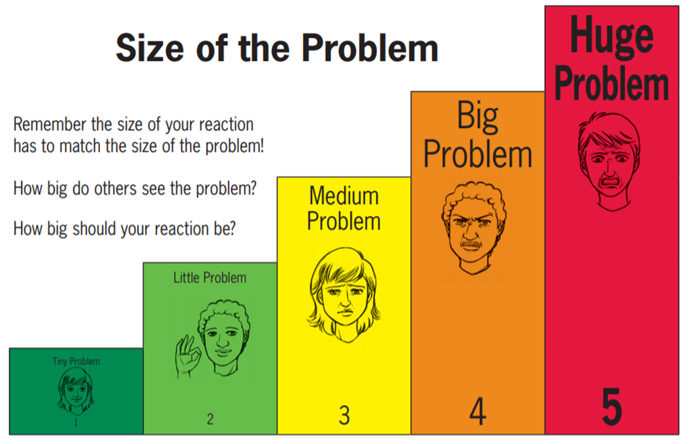

Slide 11
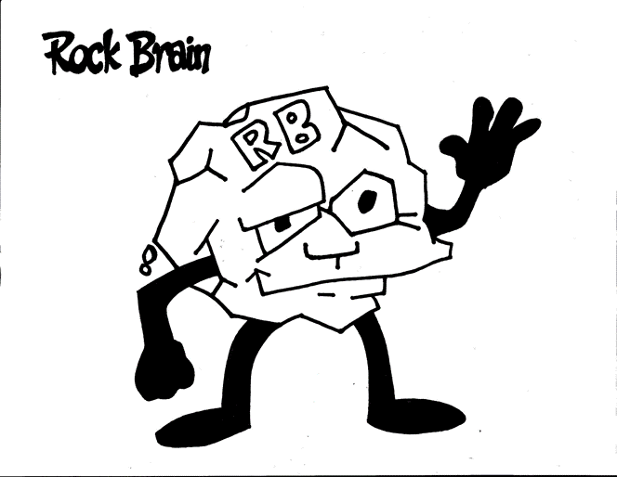
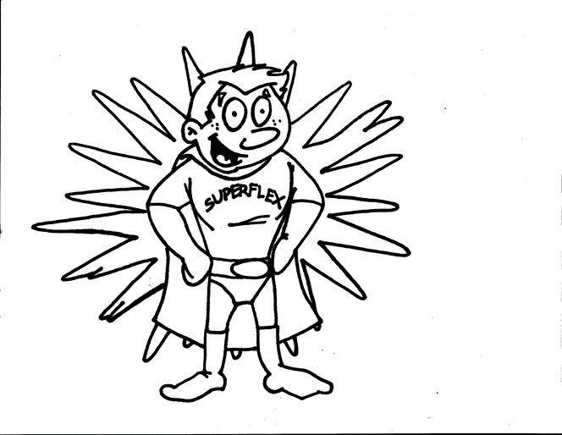
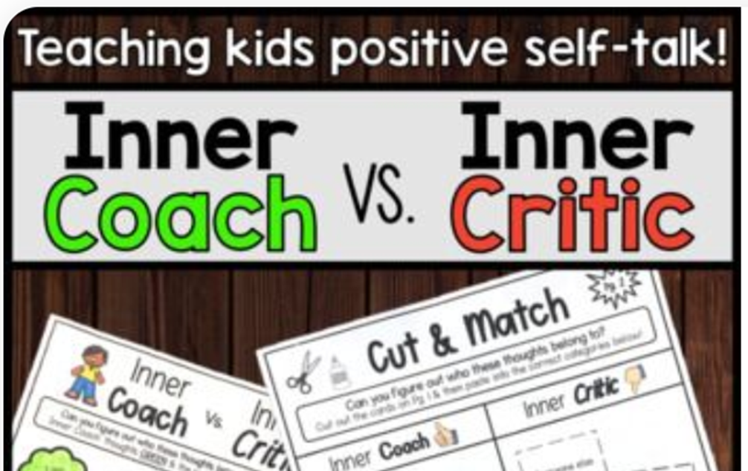

Slide 12
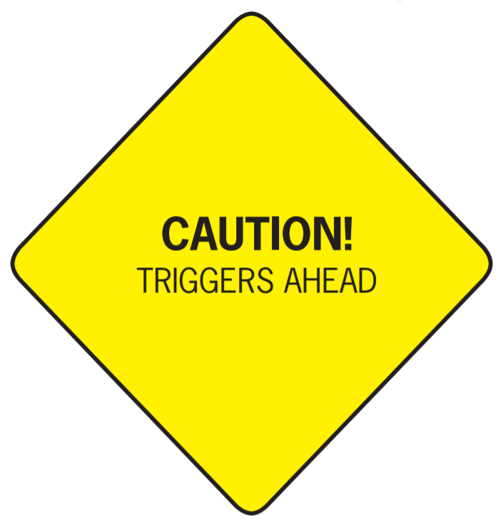
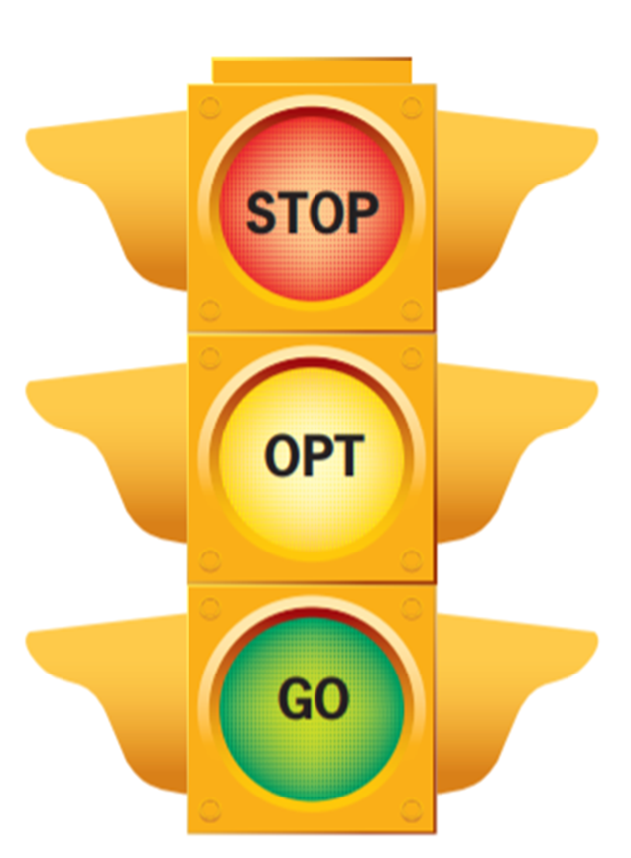

Slide 13


